Slide 1
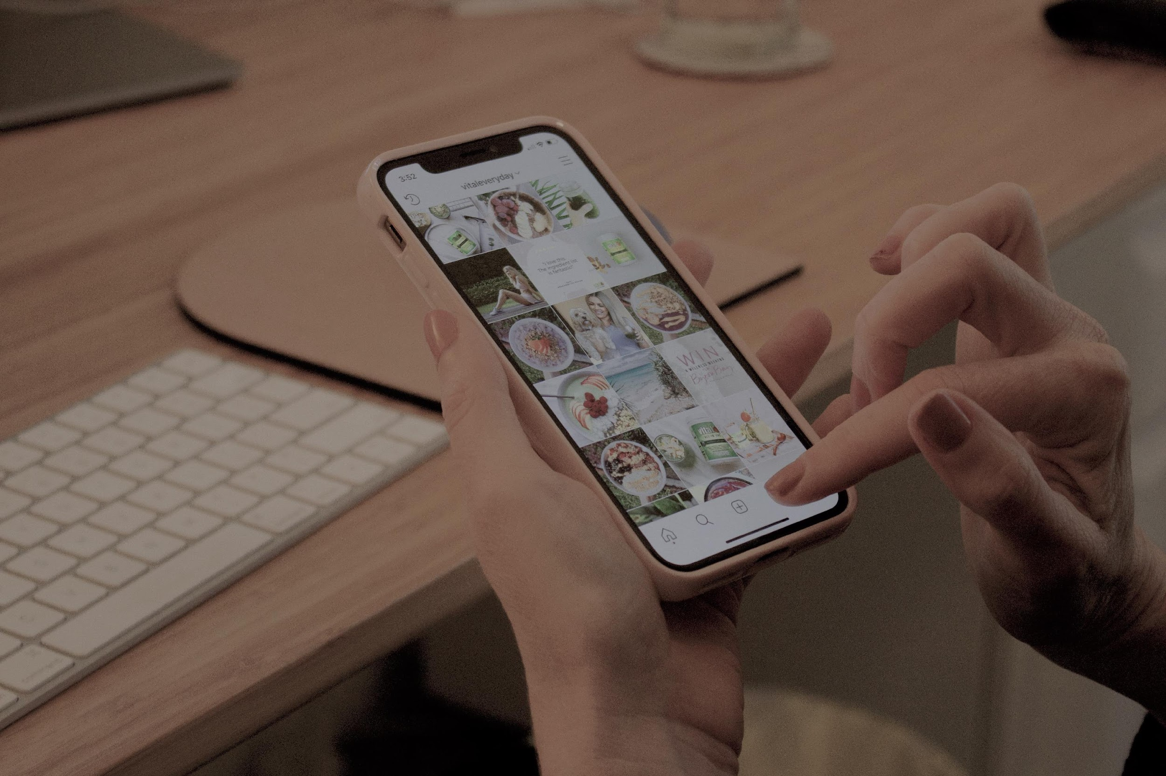

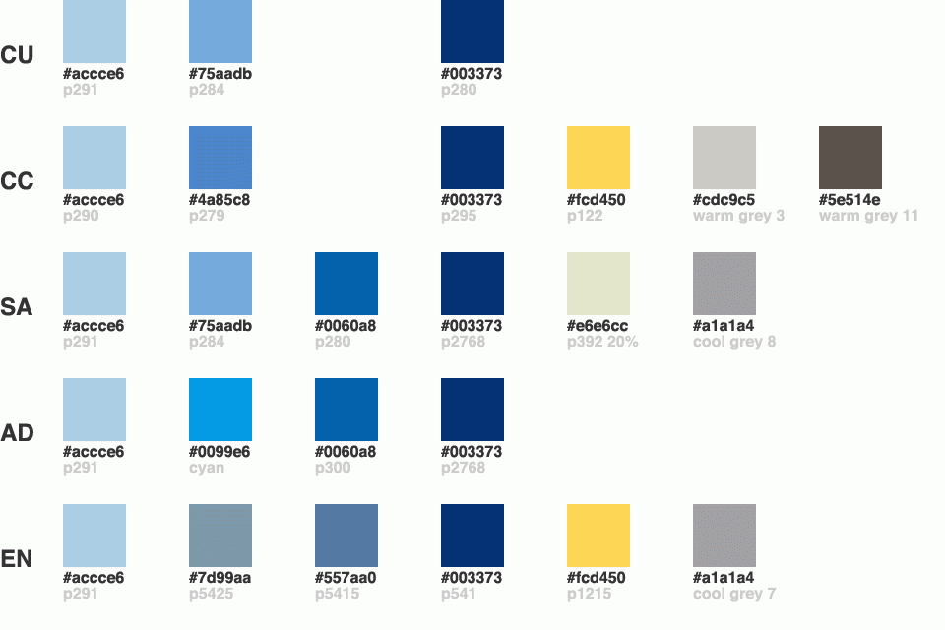
A Study on Customer Engagement on Instagram Shop
Chi Lee, Jingyi Li, Joyce Ishikawa, Maria Bifaretti, Michelle Mai, Yancheng Yu.

Slide 2
The Situation
Proposed Changes
Content
Experimental Method
Results & Recommendations
Limitations & Next Steps

Slide 3









Social Commerce
Form of online trade that uses social networks as a sales channel
Why?
Comparison of the social commerce market
Benefits:
USA
vs.
China
36.09 billion USD
363.26 billion USD
Company/Stakeholders
Business influences
Users
10x
Increase revenues & user engagement
Increase sales, reach new customers, create new experiences
New purchasing channel, convenience
Reference: Lipsman, 2021
Notes:
@Pilar - 30 to 40 seconds
Social commerce is a new form online trade that uses social media platforms as a sales channel. It has benefits for many stakeholders such as: social media platforms, business and influencers and the users.
Despite these benefits, the U.S. is still behind in terms of social commerce. For perspective, the Chinese market is 10x larger.
Our research looked to see if specific features could improve Instagram’s in-app shopping experience.
For of ecommerce that allows consumers to complete their entire shopping experience in a single place, from product discovery to purchase.
Despite these benefits, the U.S. is still behind in terms of social commerce. For perspective, the Chinese market is 10x larger.
Our research looked to implement specific features to improve Instagram’s in-app shopping experience by increasing the average daily session time within the feed .
Company: information about their customers’ behavior,

Slide 4
The Situation
Proposed Changes
Content
Experimental Method
Results & Recommendations
Limitations & Next Steps

Slide 5

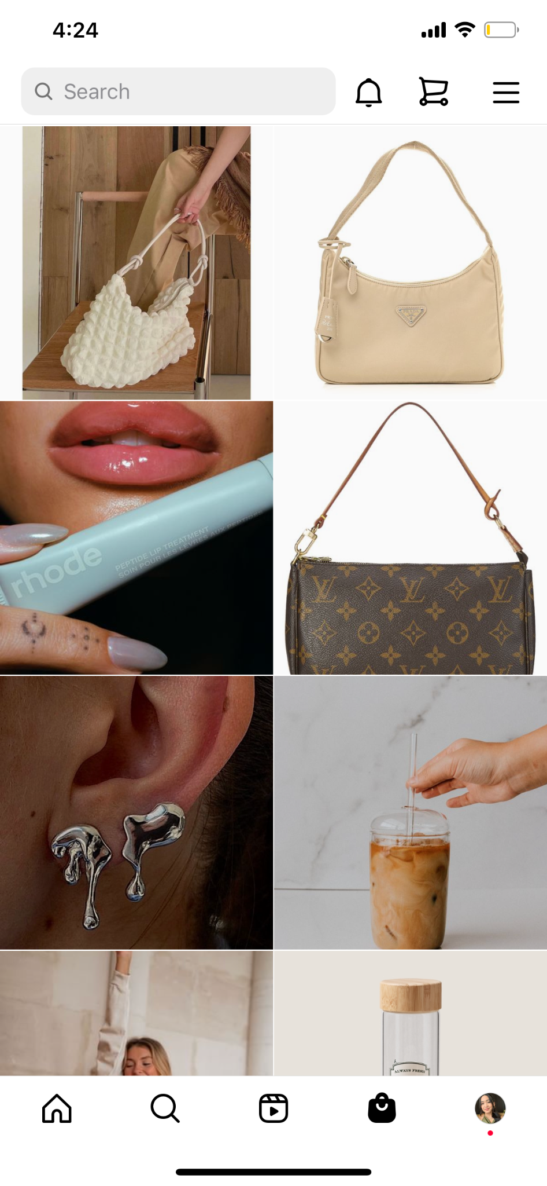
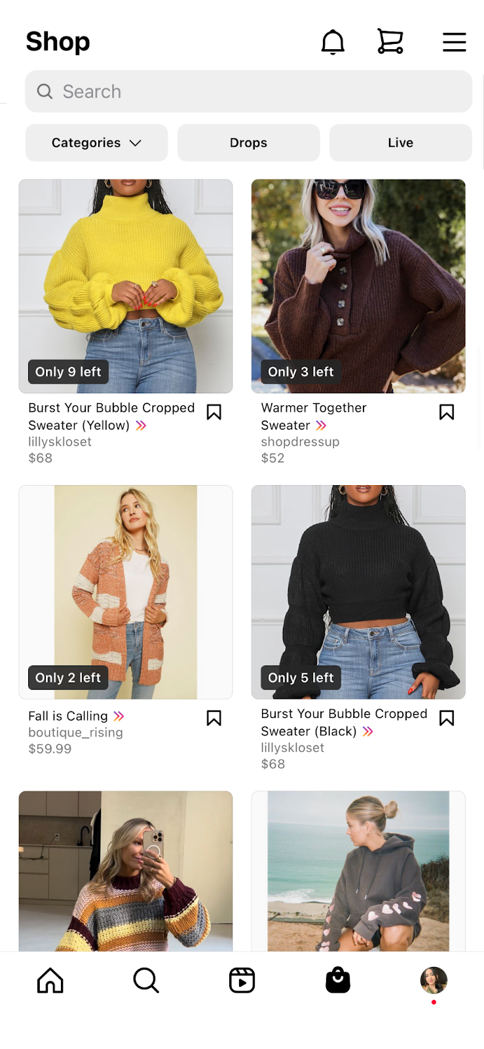
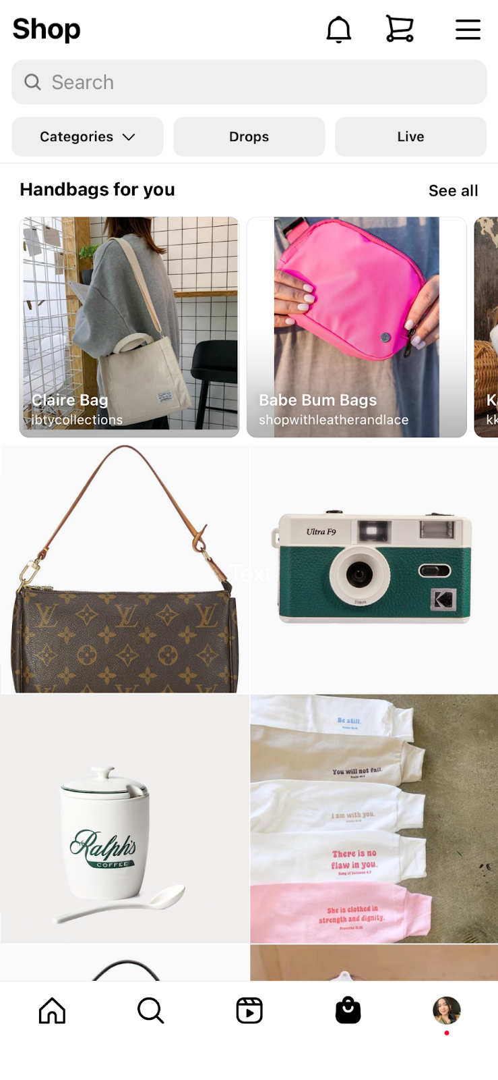
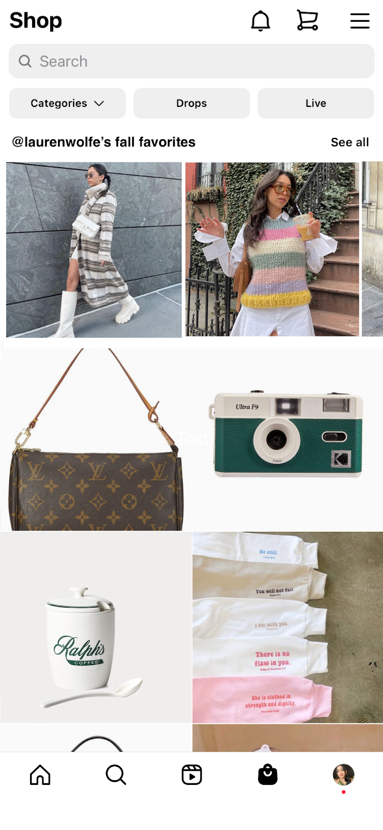
3 Proposed Changes
Control Variable
Current Shop Feed
Treatment 1
Product Categorization
Treatment 2
Creator Product Curation
Treatment 3
Price & Description
Notes:
Michelle - 30 seconds
We are planning to have three changes on the instragram shop feed. Comparing to our control group, which uses the exact shop feed that instagram currently has, treatment 1 group will present products by category based on users’ recent searches; treatment 2 group will present products that are recommended by the creators that the users follow; treatment 3 group will present product with price information and description without the need to click on the picture.

Slide 6
The Situation
Proposed Changes
Content
Experimental Method
Results & Recommendations
Limitations & Next Steps

Slide 7




Experimental Method & Operational Procedures
Variables
Sample Selection
Independent Variable
Dependent Variable
Product Categorization (TG 1)
Creator Product Curation (TG 2)
Price & Description (TG 3)
User’s Daily Average Session Time on Instagram Shop Feed
Population of Interest
Instagram users
United States
18-57 years old
Used the shop feed in the past 6 months
Statistical Test
Sample Size
Randomly assign 280 subjects
One Way ANOVA
Tukey’s Honest Significant Difference Method
Comparing the user’s daily average session time for the 4 groups
Control Group
Treatment Group 1
Treatment Group 2
Treatment Group 3
Conducting pairwise comparisons
70 subjects
70 subjects
70 subjects
70 subjects
TG = Treatment Group
Notes:
Yancheng - 2 min

Slide 8
The Situation
Proposed Changes
Content
Experimental Method
Results & Recommendations
Limitations & Next Steps

Slide 9



No Effect
Effect
Simulation: With No Effect
True Negative Rate of 98.7% indicates that the majority of our experiment resulting in significant p-values
98.7% of False Negative (Type II error) indicates that the majority of our experiment does not predict accurately
RQ1: Product Categorization
RQ2: Creator Product Curation
RQ3: Price & Description
Mean effect size: 0.00756 seconds (~0% effect size)
Mean effect size: 0.109 seconds (~0% effect size)
Mean effect size: -0.0108 seconds (~0% effect size)
NEED FURTHER ADJUSTMENTS IN DESIGN
to lower Type II Error and guarantee a change in strategy.
Notes:
Jingyi - 1 min
TN :We predicted that there is no improvement in average daily session time of Instagram users before and after releasing the three features in Shop feed, and there is actually no improvement.
FN: We predicted that there is no improvement in average daily session time of Instagram users after releasing the three feature in Shop feed, and there is actually improvement (false prediction).

Slide 10
No Effect
Effect
Simulation: With Effect
True Positive Rate of 82.3% indicates a high proportion of experiments resulting in significant p-values
82.3% of False Positive (Type I Error) rates suggest a high proportion of experiments with insignificant p-values that was considered significant
RQ1: Product Categorization
RQ2: Creator Product Curation
RQ3: Price & Description
Mean effect size: 9.01 seconds (~20% effect size)
Mean effect size: 9.11 seconds (~20% effect size)
Mean effect size: 8.99 seconds (~20% effect size)
NEED FURTHER ADJUSTMENTS IN DESIGN
to lower Type I Error and guarantee a change in strategy.
Notes:
Joyce 1 min

Slide 11
The Situation
Proposed Changes
Content
Experimental Method
Results & Recommendations
Limitations & Next Steps

Slide 12





Limitations
Authenticity
Timeframe
Interactions between the Independent Variables
With an effect
Lower Type I error
Further study on optimizing the simulations
Next Steps
No effect
Lower Type II error
Not releasing the features
In-depth study into related variables and interactions
Notes:
Chi - 1 min<

Slide 13

Thank You!

